Slide 1
Update Week 1

Slide 2
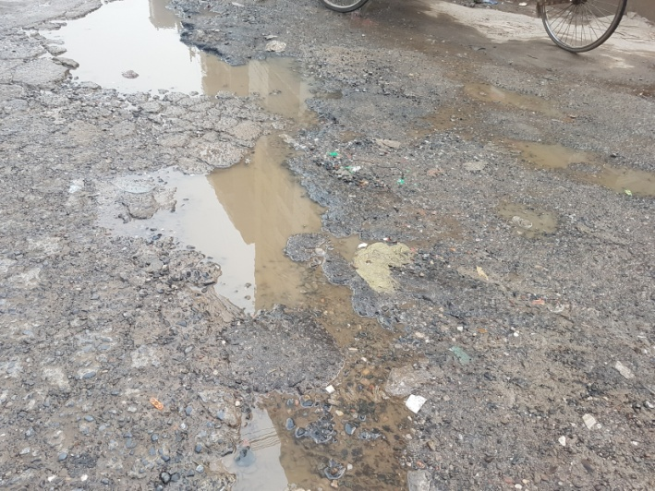
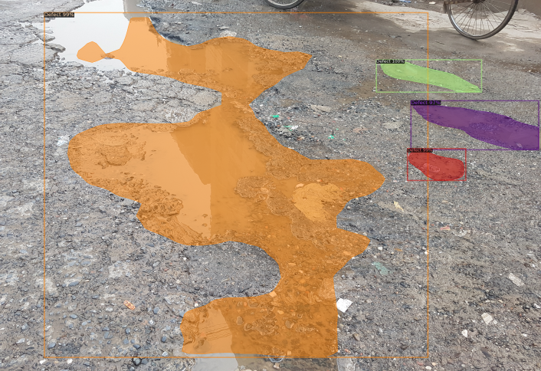
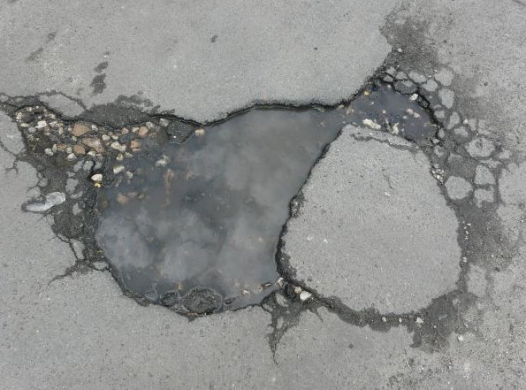
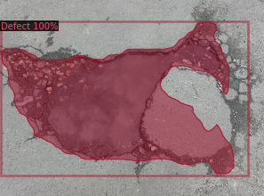

Slide 3
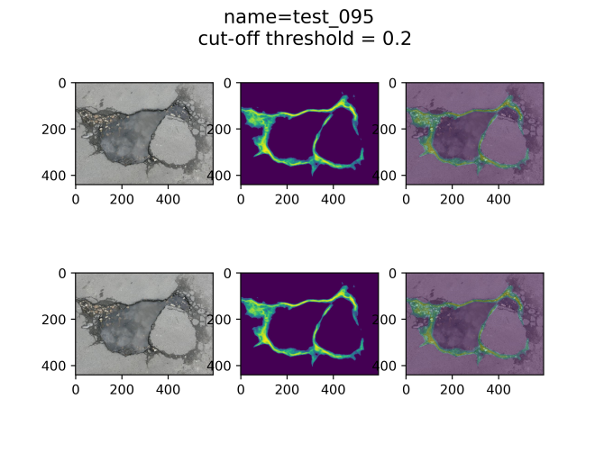
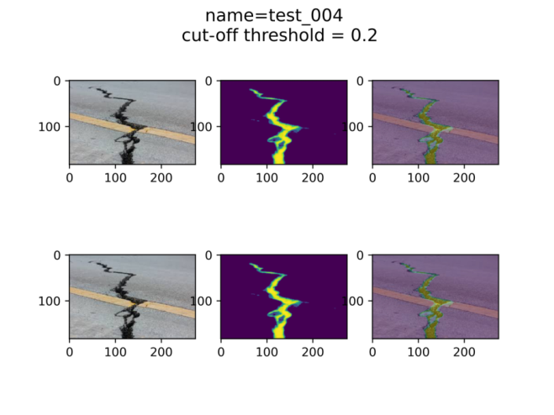
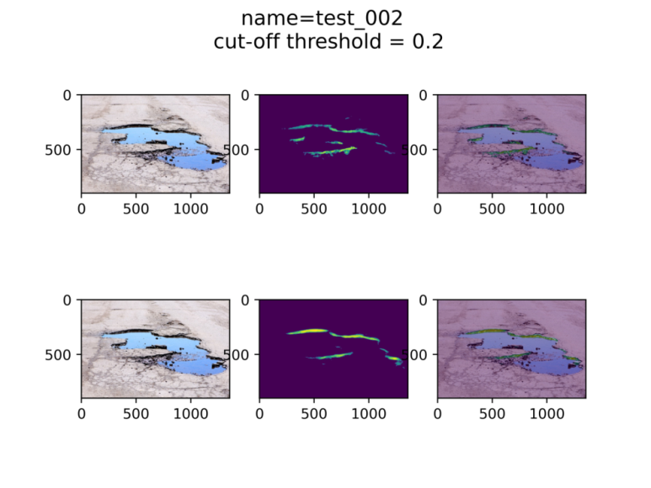
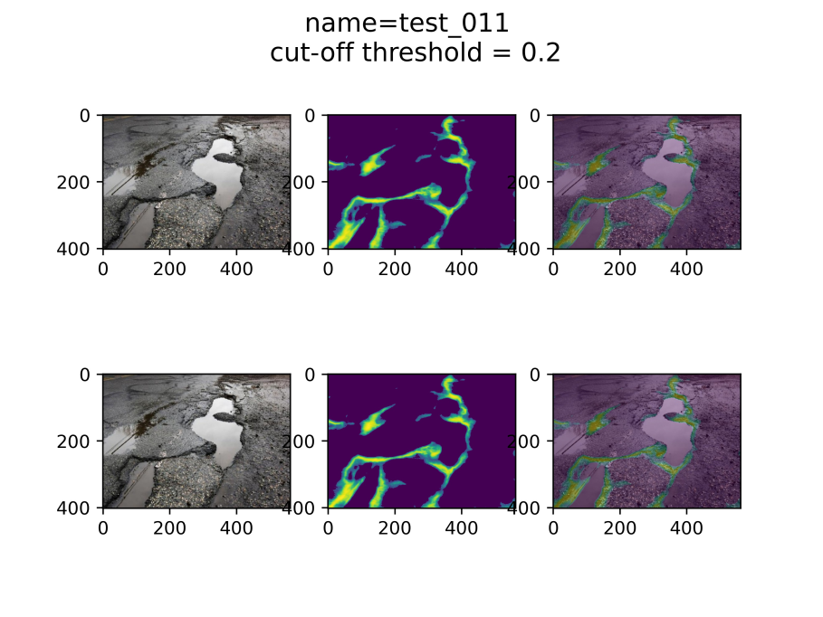
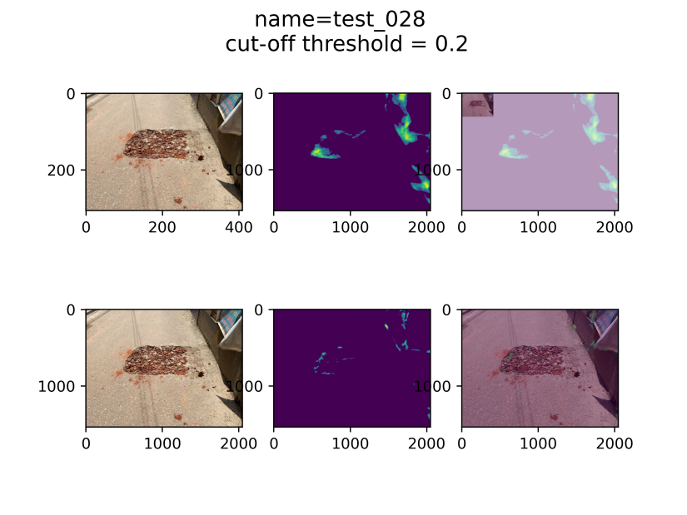

Slide 4
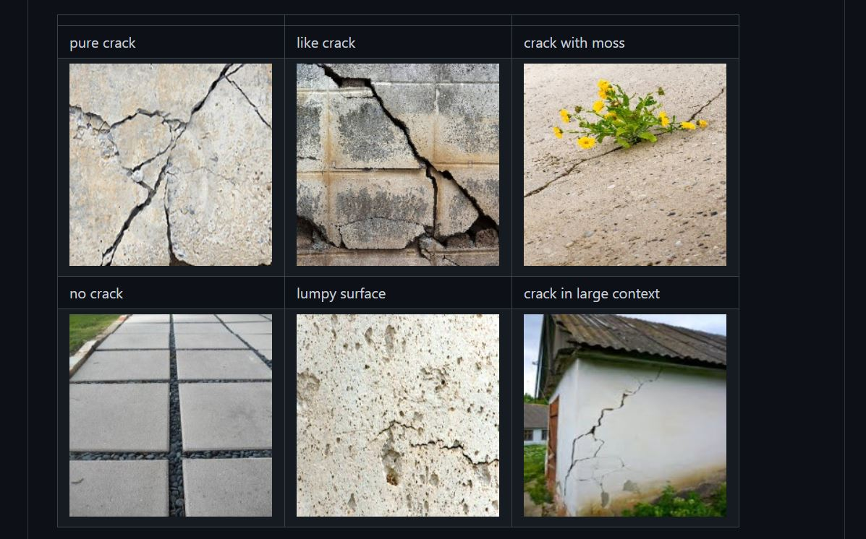
Crack 500 Data

Slide 5


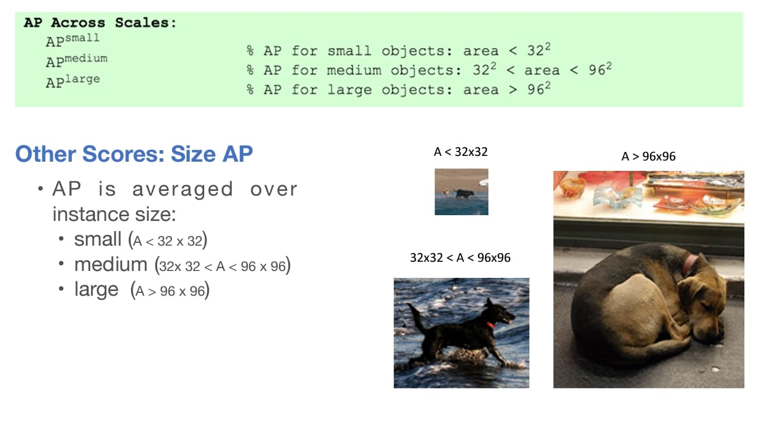
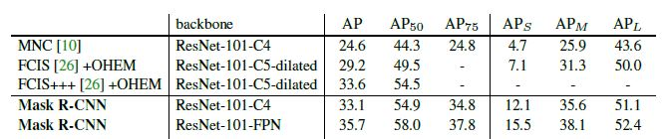
The AP result problem
Data Distribution
Train
Val

Slide 6
Batch size | Backbone | AP | AP₅₀ | AP₇₅ | AP_{S} | AP_{M} | AP_{L}
64 | ResNet-101-FPN | 25.700 | 50.884 | 21.666 | 12.453 | 24.968 | 29.970
32 | ResNet-101-FPN | 27.633 | 52.892 | 24.187 | 13.534 | 28.723 | 31.481
16 | ResNet-101-FPN | 27.120 | 52.725 | 22.992 | 12.958 | 27.004 | 31.596
8 | ResNet-101-FPN | 26.601 | 53.221 | 23.477 | 15.999 | 24.441 | 31.350
4 | ResNet-101-FPN | 28.110 | 55.028 | 25.047 | 14.784 | 26.824 | 34.167

Slide 7
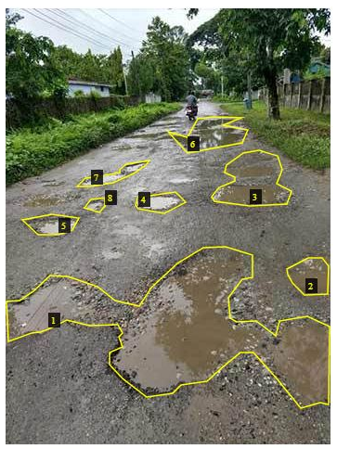
AP idea
Shoelace formula
def PolyArea(x,y):
return 0.5*np.abs(np.dot(x,np.roll(y,1))- np.dot(y,np.roll(x,1)))
Idea 1
if 0< area<32*32 : small
elif area<96*96 : medium
else area<1e20 : large
Idea 2
scale and aspect ratio of objects
aspect ratio = all width/all length
scale = polyarea
anchor box generated-128, 256, 512

Slide 8
Idea 3
plot scale, aspect_ratio
estimate anchor boxes and mean IOU from the ground truth points and number of anchors
k means clustering
mean IOU can be inscreased by increasing no of anchors

Slide 9
change in mask rcnn
In Mask R-CNN, the number of region proposals fed to Region of Interest Align (RoIAlign) is very big, generally ranging from 100 to 300. In this case, the number of segmentation maps to be learned is large, which makes it difficult to extract features in the mask branch. To solve this problem, the threshold of non-maximum suppression (NMS) in the RPN is increased from 0.5 to 0.7, and the intersection over union (IoU) threshold for NMS is fixed at 0.7(source). The setting of anchors in Faster R-CNN contains three scales of anchor boxes, and each scale corresponds to three aspect ratios. In order to adapt to the size requirements of electronic components and obtain more precise region proposals, we used five scales with box areas of 32 , 64 , 128 , 256 , and 512 pixels, and three aspect ratios of 1:1, 1:2, and 2:1.

Slide 10

Get the pixel values
Design a filter
do a summary of the pixel values

Slide 11
Dataset quest
https://towardsdatascience.com/application-of-deep-learning-in-identifying-road-cracks-8153e50ce9e2 (i can not access)
https://github.com/DeqiangWang/PID-Pavement-Image-Dataset/blob/master/Labeling.part1.rar (PID Dataset)
https://github.com/khanhha/crack_segmentation (crack500 dataset)
https://drive.google.com/file/d/1xrOqv0-3uMHjZyEUrerOYiYXW_E8SUMP/view
https://github.com/alexdonchuk/cracks_segmentation_dataset
https://github.com/yhlleo/DeepCrack
https://github.com/ccny-ros-pkg/concreteIn_inpection_VGGF

